Slide 1
PRACTICE • BUILD • MASTER
AI Development
Design Katas
14 Progressively Challenging Exercises
~30 min each • Algorithm • UI/UX • State • Probability • Visualization

Slide 2
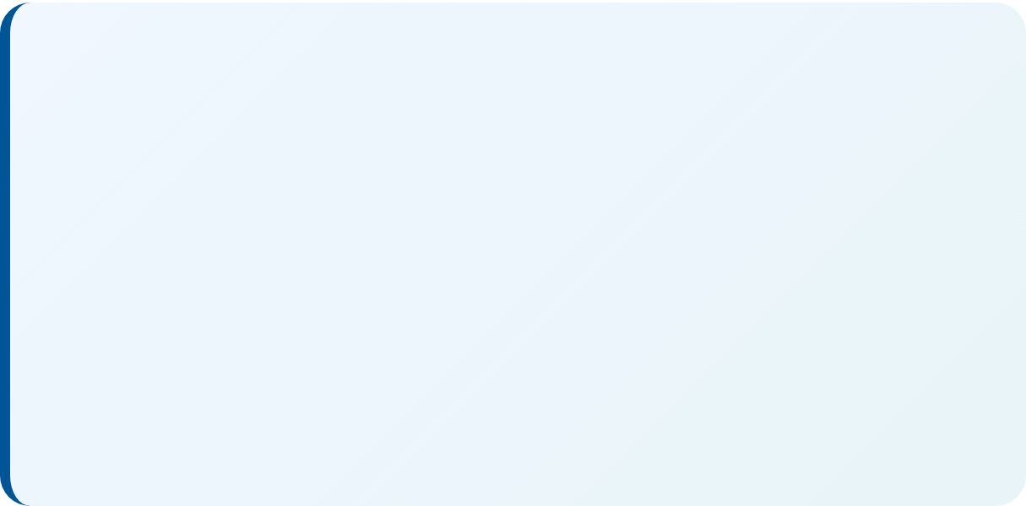
Rules and Process
How we practice with design katas
1
Build Each Kata 10 Times
Time how long it takes to complete the first and last iteration to measure improvement
THE GOAL
2
Iterate on Your AI Workflow
Between each build, update rules, workflows, and tools in your AI development environment
Build transferable AI development skills that compound across every project you work on.
3
Keep Instructions Generic
No kata-specific instructions in workflows and rules - they must work for the next kata too
ITERATION LOOP
4
Monthly Cadence
We do this monthly as a group - private practice available for those who want to go faster

Slide 3
Texas Hold'em Probability Simulator
CHALLENGE
At a 9-handed Texas Hold'em table without betting or folding, deal hands to all players and display each hand in the UI. Show live win probability percentages for each player that update as community cards are revealed through the flop, turn, and river.
STRETCH GOALS
Add hand strength classification labels (high card through royal flush) updating in real-time
Implement equity all-in scenarios showing exact odds vs Monte Carlo estimates
KEY CHALLENGES
Add what if mode to set specific cards for any player
Monte Carlo simulation, card deck management, probability calculation, responsive UI updates
Show outs count and percentage for drawing hands
Expert | Alg 1 | UI 1 | State 1 | Math 2 | Viz 0

Slide 4
Sorting Algorithm Visualizer
CHALLENGE
Create a visual comparison tool that animates at least 4 sorting algorithms (bubble, insertion, merge, quicksort) side-by-side on randomized arrays of 50 elements. Include controls for speed, array size, and a step counter showing comparisons/swaps for each algorithm.
STRETCH GOALS
Add sound effects where pitch corresponds to element value being compared/swapped
Include Big-O notation with real-time tracking vs theoretical bounds
KEY CHALLENGES
Implement heap sort, radix sort, shell sort, tim sort
Algorithm implementation, synchronized animation timing, state management across multiple visualizations
Add race mode with finish-line animation
Intermediate | Alg 2 | UI 1 | State 1 | Math 0 | Viz 2

Slide 5
Pathfinding Grid Explorer
CHALLENGE
Build an interactive grid where users can place start/end points and draw walls. Implement A* and Dijkstra's algorithms with step-by-step visualization showing frontier expansion, visited nodes, and final path. Display path length and nodes explored for comparison.
STRETCH GOALS
Add weighted terrain (swamp, road, walls) with different traversal costs
Implement bidirectional search and visualize the meeting point
Add maze generation algorithms (recursive backtracking, Prim's, Kruskal's)
KEY CHALLENGES
Support diagonal movement with proper cost calculation
Priority queue implementation, heuristic functions, click/drag wall drawing, animation pacing
Advanced | Alg 2 | UI 2 | State 1 | Math 0 | Viz 2

Slide 6
Conway's Game of Life Sandbox
CHALLENGE
Implement Conway's Game of Life with a resizable grid, play/pause/step controls, adjustable speed, and pattern library (glider, blinker, pulsar, glider gun). Include generation counter and live cell count. Allow users to draw cells and save/load patterns.
STRETCH GOALS
Add alternative rulesets (HighLife, Day and Night, Seeds) with a rule editor
Implement pattern detection for stable states or cycles
Add trail mode showing cell age with color gradients
KEY CHALLENGES
Support RLE pattern import/export for pattern library compatibility
Efficient neighbor counting, boundary conditions, pattern storage format, performant rendering
Beginner | Alg 1 | UI 1 | State 2 | Math 0 | Viz 1

Slide 7
Blackjack with Strategy Coach
CHALLENGE
Create a blackjack game against a dealer following standard casino rules. Display the mathematically optimal play (hit, stand, double, split) for each situation based on basic strategy charts. Track player decisions against optimal and show accuracy percentage over time.
STRETCH GOALS
Add card counting simulation (Hi-Lo system) with running/true count
Implement configurable house rules (decks, soft 17, surrender)
Show expected value for each decision option
KEY CHALLENGES
Add training mode focusing on common mistake scenarios
Strategy lookup table, multi-hand split logic, soft/hard hand distinction, running statistics
Intermediate | Alg 1 | UI 1 | State 1 | Math 2 | Viz 0

Slide 8
Wordle Clone with Analysis
CHALLENGE
Build a Wordle clone with a 5-letter word dictionary. After each guess, show remaining possible words based on revealed constraints. Include a solver mode that suggests optimal next guesses based on letter frequency analysis of remaining possibilities.
STRETCH GOALS
Implement information theory scoring (bits gained per guess)
Add hard mode enforcement (must use revealed hints)
Create adversarial mode that changes target word to maximize guesses
KEY CHALLENGES
Support variable word lengths (4-7 letters)
Word filtering logic, keyboard state tracking, optimal guess heuristics, dictionary management
Intermediate | Alg 1 | UI 2 | State 1 | Math 1 | Viz 0

Slide 9
Snake with Replay System
CHALLENGE
Implement classic Snake with arrow key controls, increasing speed, and score tracking. Record all game states and allow users to replay any completed game at variable speeds. Include a ghost snake showing the replay while playing a new game.
STRETCH GOALS
Add AI autopilot using pathfinding to chase food safely
Implement time rewind to undo the last N moves during gameplay
Create leaderboard with shareable replay links (URL-encoded states)
KEY CHALLENGES
Add obstacles and power-ups (speed boost, wall pass-through)
Input handling, collision detection, state serialization, synchronized playback
Beginner | Alg 1 | UI 1 | State 2 | Math 0 | Viz 0

Slide 10
Tic-Tac-Toe with Unbeatable AI
CHALLENGE
STRETCH GOALS
Create Tic-Tac-Toe with three modes: PvP, Easy AI (random), and Impossible AI (minimax). The impossible AI should never lose. Show the AI's evaluation of each possible move when playing against it, visualizing why it chose its move.
Extend to Ultimate Tic-Tac-Toe (9 boards with meta-game rules)
Add 4x4 or 5x5 grid variant with 4-in-a-row to win
KEY CHALLENGES
Implement teaching mode showing optimal responses after mistakes
Minimax with alpha-beta pruning, move evaluation display, game state detection
Create adjustable difficulty with deliberate suboptimal moves
Beginner | Alg 2 | UI 1 | State 1 | Math 0 | Viz 1

Slide 11
Loan Amortization Dashboard
CHALLENGE
Build a mortgage/loan calculator that generates a full amortization schedule from principal, rate, and term inputs. Visualize the payment breakdown (principal vs interest) over time with an area chart. Allow extra payment scenarios and show time/interest saved.
STRETCH GOALS
Compare multiple scenarios side-by-side (15 vs 30 year, different rates)
Add refinancing analysis with current loan state comparison
Implement bi-weekly payment option with accelerated payoff
KEY CHALLENGES
Include tax implications (mortgage interest deduction)
Amortization formula, chart rendering, scenario comparison, currency formatting
Expert | Alg 0 | UI 1 | State 1 | Math 2 | Viz 2

Slide 12
Pomodoro Timer with Analytics
CHALLENGE
STRETCH GOALS
Create a Pomodoro timer (25 min work / 5 min break) with audio notifications. Track completed sessions per day and visualize weekly productivity as a heat map. Include customizable durations and a distraction log where users can note interruptions.
Add task association and track time per task
Implement long break logic (longer break after every 4 pomodoros)
KEY CHALLENGES
Create streak tracking with daily/weekly goals and badges
Accurate timing, notification API, local storage, heat map visualization
Export data as CSV or calendar integration
Beginner | Alg 0 | UI 2 | State 2 | Math 0 | Viz 1

Slide 13
Color Palette Generator
CHALLENGE
Generate harmonious color palettes using different color theory rules (complementary, triadic, analogous, split-complementary). Given a base color, display the generated palette with hex/RGB values, contrast ratios for accessibility, and a preview component.
STRETCH GOALS
Extract dominant colors from uploaded images to seed palettes
Add color blindness simulation preview (protanopia, deuteranopia)
Generate CSS custom properties or Tailwind config export
KEY CHALLENGES
Implement palette locking (lock colors while regenerating others)
HSL color space manipulation, WCAG contrast calculation, color harmony algorithms
Intermediate | Alg 1 | UI 2 | State 0 | Math 1 | Viz 1

Slide 14
Binary Search Tree Visualizer
CHALLENGE
Build an interactive BST where users can insert, delete, and search for values. Animate each operation showing comparisons and rotations. Support in-order, pre-order, and post-order traversal animations. Display tree height and balance factor for each node.
STRETCH GOALS
Implement AVL or Red-Black tree with rebalancing animations
Add bulk insert with tree evolution visualization
Include pathological case demos (sorted input to linked list)
KEY CHALLENGES
Support expression trees with evaluation animation
Tree layout algorithm, operation animation sequencing, balanced rendering of unbalanced trees
Advanced | Alg 2 | UI 1 | State 2 | Math 0 | Viz 2

Slide 15
Sudoku Generator and Solver
CHALLENGE
Create a Sudoku game that generates puzzles at easy/medium/hard difficulty levels. Include a hint button that fills one cell and a solve button that animates the backtracking solution process. Validate user input in real-time with conflict highlighting.
STRETCH GOALS
Add pencil marks (candidates) with automatic constraint elimination
Visualize advanced techniques (naked pairs, hidden singles, X-wing)
Create rate my puzzle analyzing techniques required to solve
KEY CHALLENGES
Support variant sudoku (killer, thermometer, diagonal)
Puzzle generation with unique solutions, difficulty estimation, efficient solving visualization
Advanced | Alg 2 | UI 2 | State 1 | Math 0 | Viz 1

Slide 16
Password Generator with Entropy Meter
CHALLENGE
Build a password generator with toggles for length, uppercase, lowercase, numbers, and symbols. Calculate and visualize the password's entropy in bits and estimated crack time against various attack scenarios. Include a pronounceable mode using consonant-vowel patterns.
STRETCH GOALS
Add passphrase generation using diceware-style word lists
Implement memorable password using word + number + symbol patterns
Check against Have I Been Pwned API
KEY CHALLENGES
Add password strength analyzer for user-input passwords
Cryptographic randomness, entropy calculation, crack time estimation, pronounceable generation algorithm
Intermediate | Alg 1 | UI 1 | State 0 | Math 2 | Viz 1

